Slide 1
Data Analysis of Cancer Mortality Trends: Informing Future Research Directions
CAPSTONE EDA PROJECT

Slide 2

Data Source and Overview
DATA SOURCE: CDC WONDER
CDC WONDER: Developed by the Centers for Disease Control and Prevention (CDC)
https://wonder.cdc.gov/cancermort-v2021.HTML
DATA OVERVIEW:
Cancer Mortality Data: 1991 to 2021
Data included: Year, Age Group, Race, Sex, Leading Cancer Site
United States (excluding Puerto Rico)

Slide 3
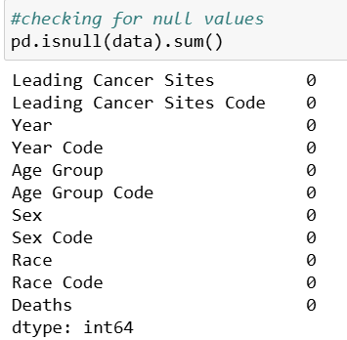

Data Examination and Cleaning
Python was used to examine the dataset
Findings:
· No null values present in data
· No duplicate entries detected
· No data cleaning was required
Analysis and Visualizations were conducted using Tableau

Slide 4
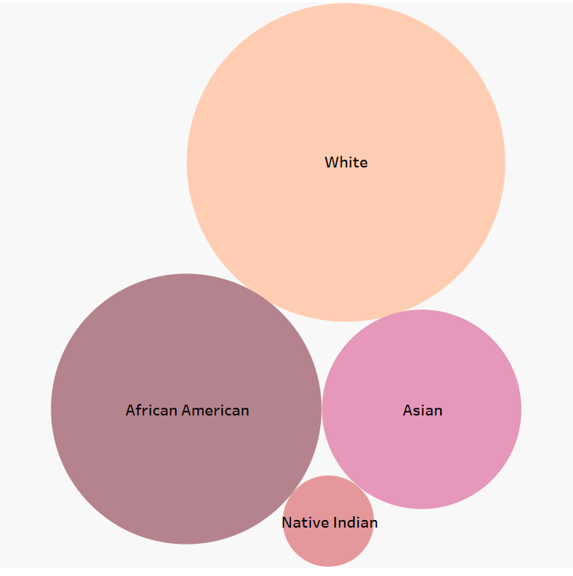
Data Shows Significant Racial Disparity: Majority of Records for Whites, with Limited Data for Asians and Native Americans

Slide 5
Death rates for Cancer in the US has been decreasing due to advancements in technology
HYPOTHESIS
Notes:
I state the hypothesis.

Slide 6
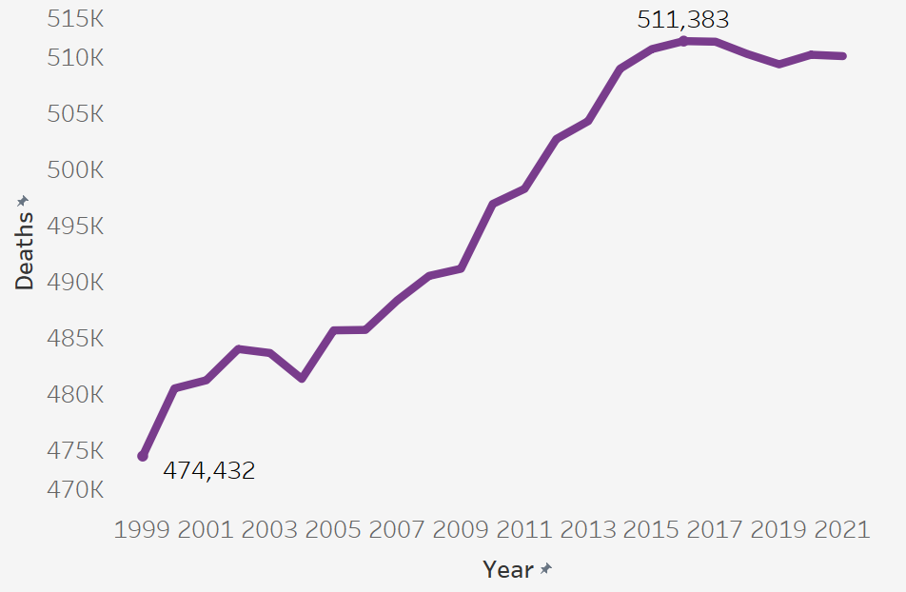
Death rate rose over time, however it stabilized 2017 and on
Notes:
We found that it is increasing. This could be similar to helmet case.

Slide 7
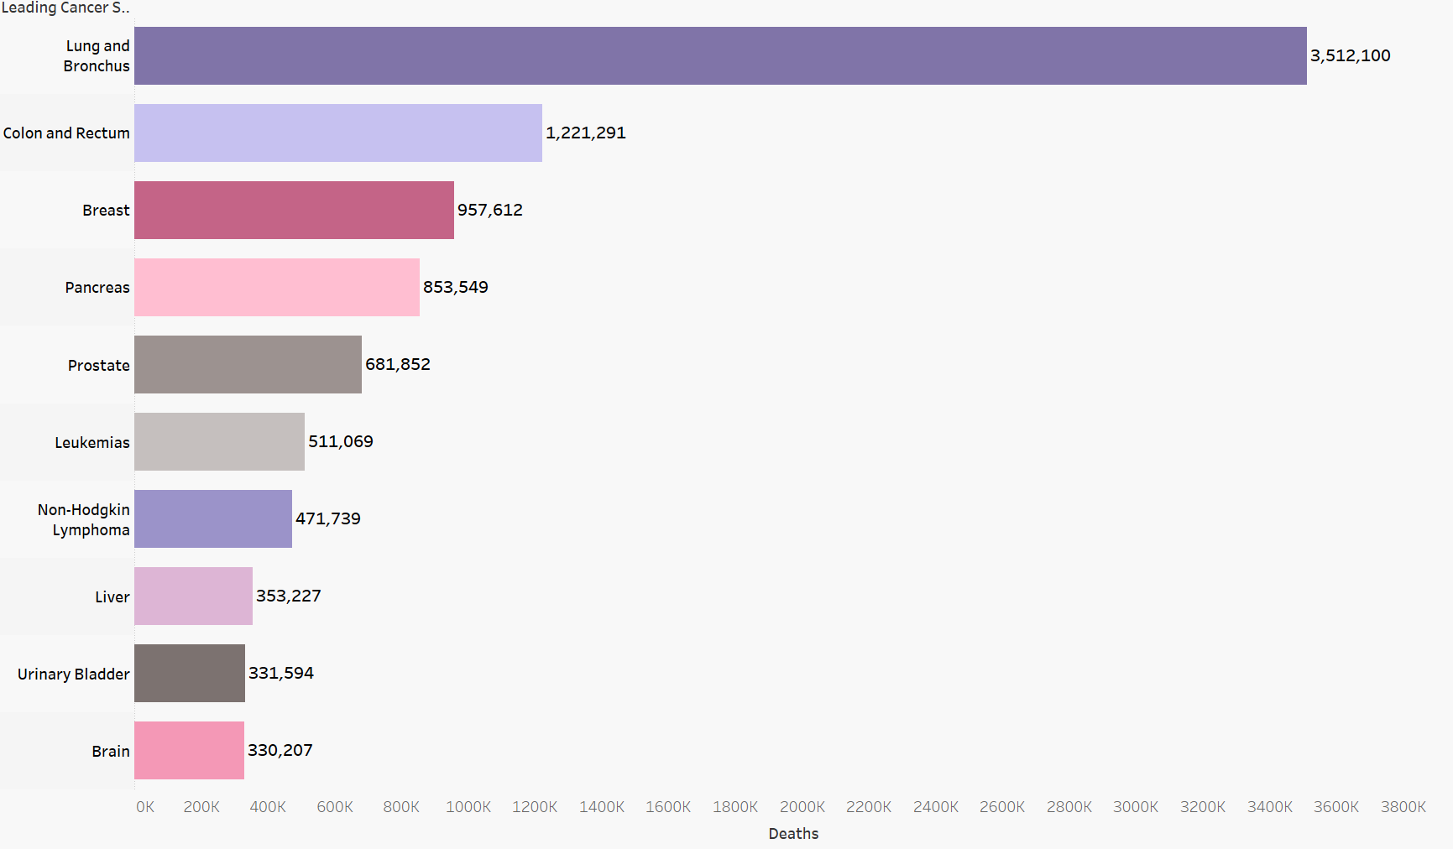
Lung and Bronchus cancer is the leading cause of cancer deaths
Notes:
Leading cause of cancer overall.

Slide 8
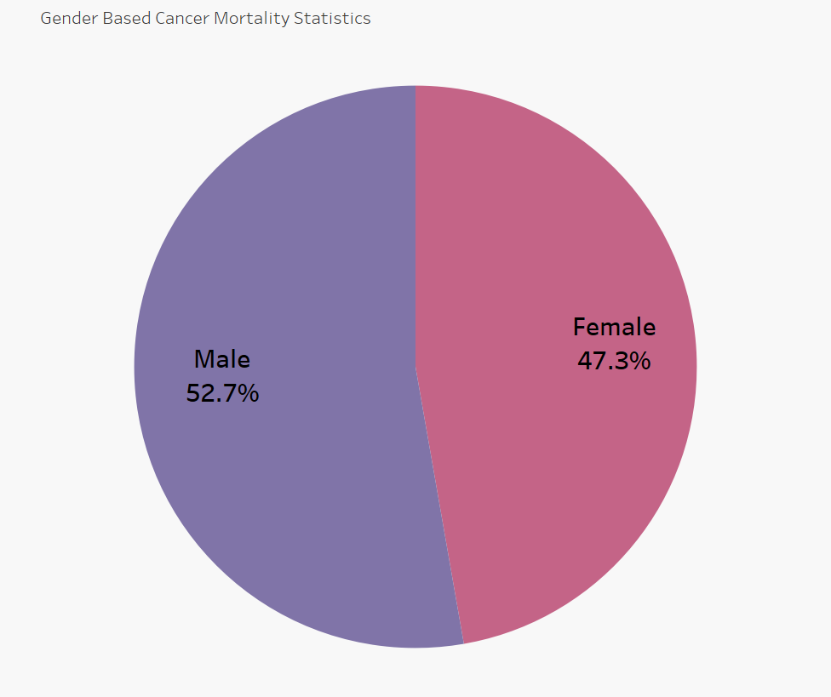
Cancer mortality is higher among males compared to females

Slide 9
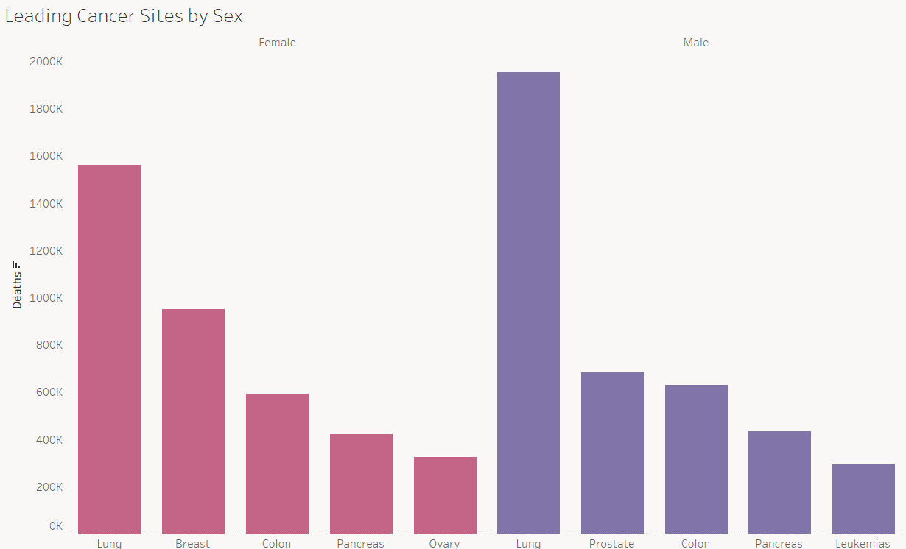
Lung cancer is the leading cause of death for both male and female.

Slide 10
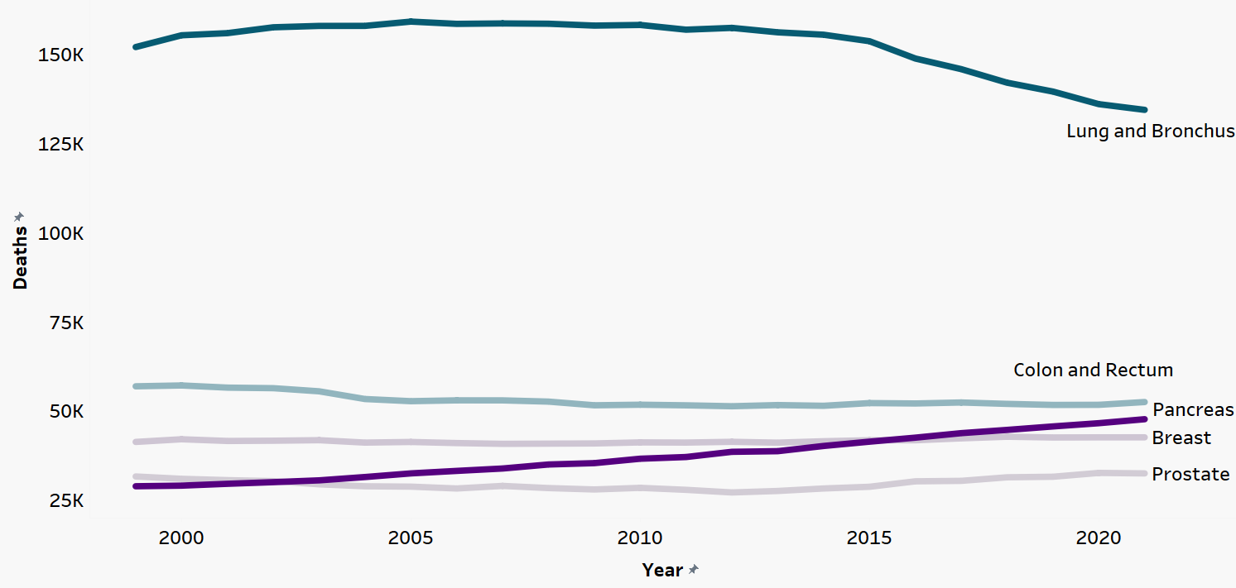
Although Lung Cancer has decreased over time, pancreatic cancer has increased.

Slide 11
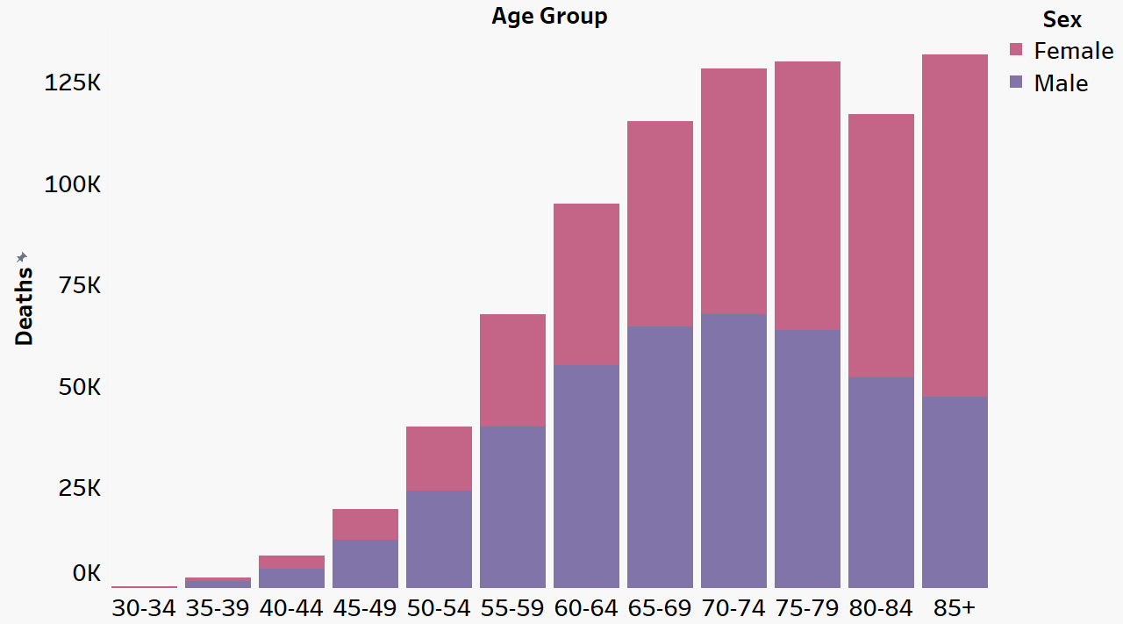
Pancreatic Cancer Mortality Peaks in Senior Age Groups: Females Show Higher Mortality in Advanced Age
Notes:
Prevalent cancer type for high age groups
Female show higher mortality numbers, could be correlated to life expectancy.

Slide 12
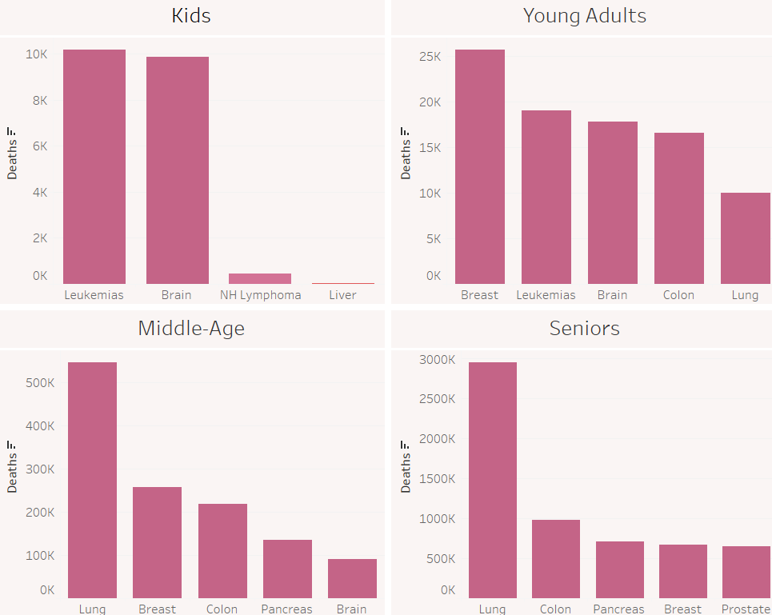
Leading Cancer Types Differ by Age Group
Notes:
Although the overview of cancer sites show lung, colon and pancreatic cancers are the most prevalent among the entire population, this is not the case when cancer mortality is broken down by age group.
For the two older age groups (middle age and seniors) lung, colon, breast and pancreatic cancer remains prevelant.
However for children and young adults, the story is very different.

Slide 13
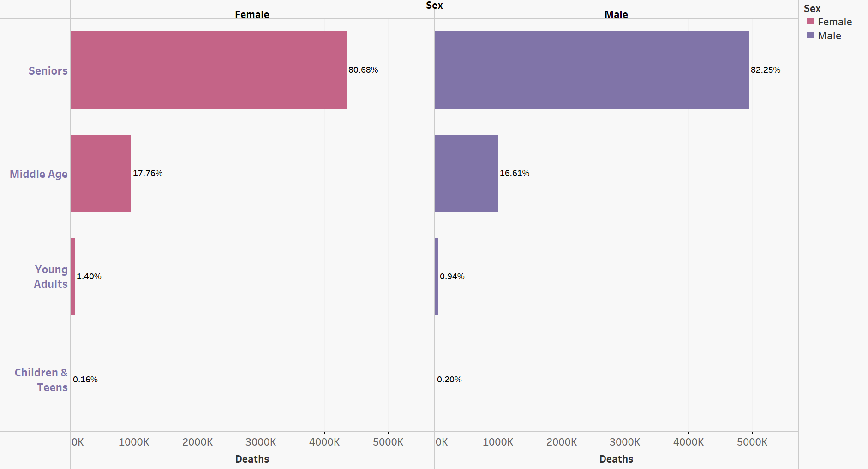
Cancer mortality is highest in the senior age group.

Slide 14
Conclusions and Recommendations
Stability in cancer mortality in recent years.
Lung cancer deaths have decreased since 2006, likely due to reduced smoking.
Focus on researching leading cancer sites by age group.
Promote awareness and funding for early detection and treatment.
Monitor the rise in pancreatic cancer.
Notes:
Based on our findings we would recommend more efforts to bring awareness to Cancers of Children and teens and young adults (Breast, Leukemia, and Brain Cancers) as they are significantly impacting our future workforce. The Cancers should also be a focus by administrations to both promote awareness and also fund more research for preventative measures and treatment. We would also recommend a focus on Pancreatic cancers as well. While advancements in technology contributed to a slight decrease in cancer mortality around 2017, the trend has since stabilized. Factors such as population growth, rising pollution, unhealthy diets, and sedentary lifestyles make it unlikely that we will see a sustained downward trend in mortality rates moving forward.

Slide 15
Thank You

Slide 16
APPENDIX

Slide 17
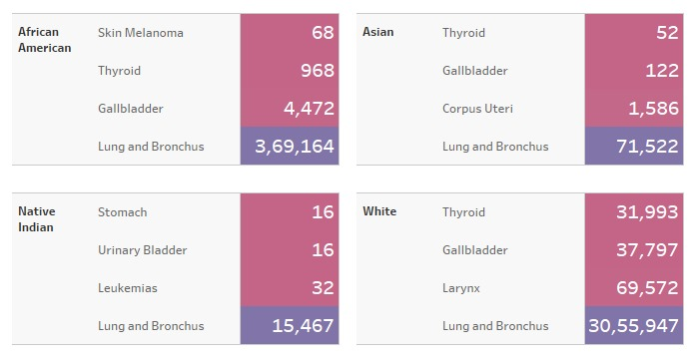
Race-Based Cancer Mortality: Lung Cancer Dominates as Leading Cause of Death

Slide 18
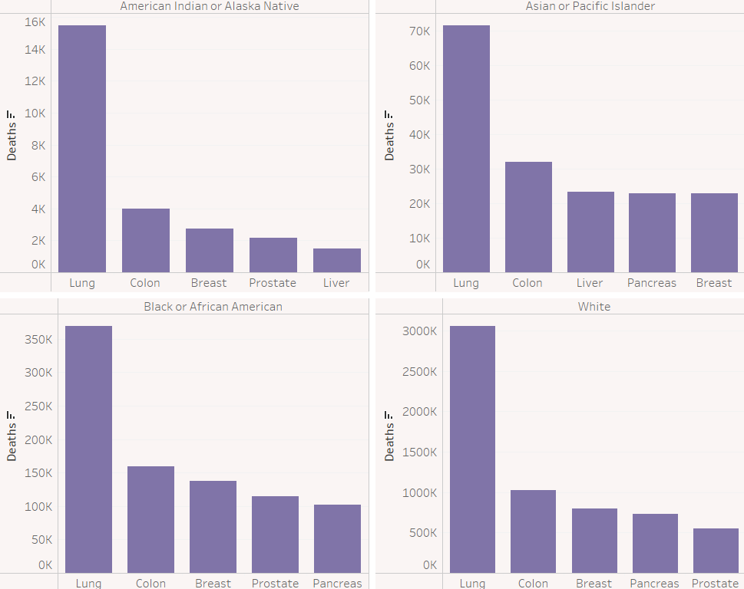
The leading cancer sites are similar across races

